Slide 1
Overview of OS
Contents: OS Objectives and Functions, The evolution of OS, Development Leading to Modern OS, VM, Shell Programming

Slide 2
What is OS?
A system program that acts as an intermediary between a user of a computer and the computer hardware.
Operating Systems goals:
  Execute user programs and make solving user problems easier.
  Make the computer system convenient to use. (User interface, API)
  Use the computer hardware in an efficient manner.

Slide 3
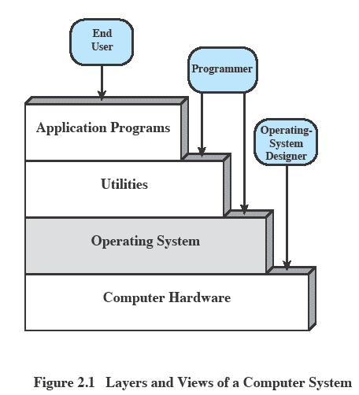
Layers and Views

Slide 4
OS Functions
Process Management
Memory Management
Secondary Storage Management
I/O Managements
Support for Networking
File managements
Shell as Command Interpreter System
Graphical User Interface
System protection and Security

Slide 5
Functions of OS?
Interface - Acts as an abstract virtual machine
    Hides the details from user
    Control execution of programs and operations of control devices
Resource manager - Maximize system utilization and/or performance
    Time and space
    Sharing of limited or expensive physical resources
    Provides Protection
    File storage, network communications, etc.

Slide 6
Evolution of OS
Early Systems (1950)
Simple Batch Systems (1960)
Multiprogrammed Batch Systems (1970)
Time-Sharing and Real-Time Systems (1970)
Personal/Desktop Computers (1980)
Multiprocessor Systems (1980)
Networked/Distributed Systems (1980)
Web-based Systems (1990)

Slide 7
Today’s Range of OS
Mainframe operating systems (z/OS, Z/VM, Linux)
Server operating systems (Mac OS X Server, Windows Server)
Multiprocessor operating systems (Unix, NT, 2000)
Personal computer operating systems (Windows 7,8, XP)
Real-time operating systems (RTLinux, Windows CE)
Embedded operating systems (Embedded linux, BlackBerry iOS)
Smart card operating systems

Slide 8
Development Leading to Modern OS
Monolithic
Microkernel
Layered Kernel
Nano kernel

Slide 9
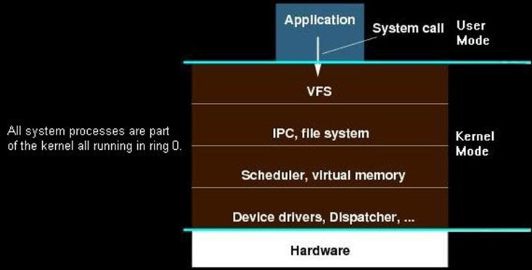
Monolithic

Slide 10
Monolithic
The term "Monolithic". The first part--"Mono" means "one". The second part--"lithic" means "it is like stone".
The entire Kernel executes in Kernel space at Ring 0. It provides a higher level interface over computer resources and hardware. It also provides a basic set of system calls via the System API.

Slide 11
Monolithic
Most of Kernel services are part of the kernel, itself. This does not mean that the services cannot be independent of each other. However, the software is very tightly integrated to the rest of the kernel. This makes monolithic kernels very fast and efficient, compared to other designs.
Because all OS services run in kernel space as part of the kernel (or as an extension to the kernel), if there is a problem with a device driver or a system service program, it can cause the entire system to crash.

Slide 12
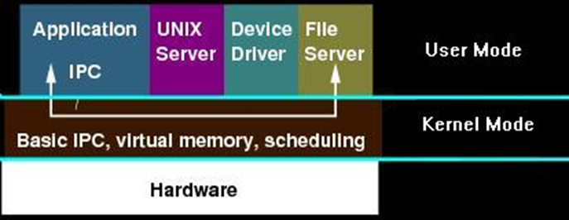
Microkernel

Slide 13
Microkernel
This structure removes all non-essential components from the kernel and implement them as system and user level programs.
Microkernel typically provides minimal process and memory management in addition to communication facility.
The main function of microkernel is to provide the communication facility between the client program and the various services that are also running in user space.
It provides more security and reliability since most services are running as user- rather than kernel processes.

Slide 14
Modern OS
Multithreading - Process is divided into threads that can run concurrently. Thread is the dispatchable unit of work executes sequentially and is interruptible, Process is a collection of one or more threads
Symmetric multiprocessing (SMP) - There are multiple processors, share same main memory and I/O facilities, All processors can perform the same functions
Distributed - Provides the illusion of a single main memory space and single secondary memory space
Object-oriented design - Used for adding modular extensions to a small kernel, Enables programmers to customize an operating system without disrupting system integrity

Slide 15
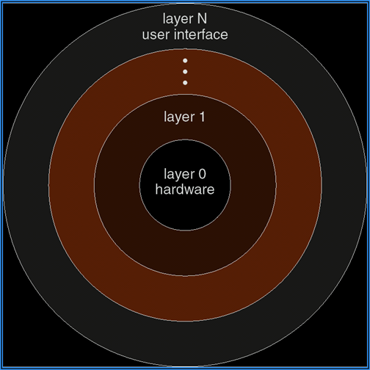
Layered Kernel

Slide 16
Layered Kernel
The OS is broken up into number of layers (or levels), each built on top of lower layers. The bottom layer (layer 0) is the hardware and highest (layer N) is the user interface. The main advantage is modularity.
The layers are selected such that each uses functions (or operations) and services of only lower-level layers. This approach simplifies debugging and system verification.

Slide 17
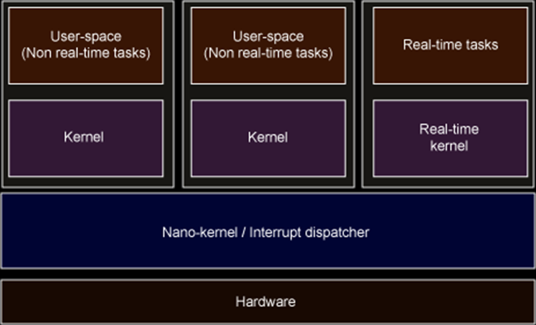
Nano Kernel

Slide 18
Nano Kernel
A kernel where the total amount of kernel code, i.e. code executing in the privileged mode of the hardware, is very small.
The term picokernel was sometimes used to further emphasize small size.

Slide 19
Thread
  The unit of dispatching is referred to as a thread or lightweight process
  The unit of resource ownership is referred to as a process or task

Slide 20
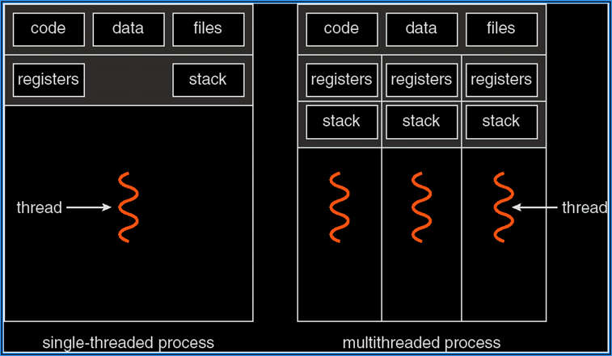
Single and Multithreaded Process

Slide 21
User and Kernel Threads
Thread management done by user-level threads library
  Three primary thread libraries: POSIX Pthreads, Win32 threads and Java threads
Kernel Threads are supported by the Kernel, Examples
  Windows XP/2000, Solaris, Linux and Mac OS X

Slide 22
Multi Threading Models
Many-to-One
One-to-One
Many-to-Many

Slide 23
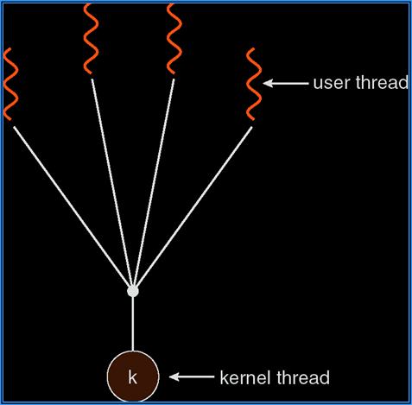
Many-to-one

Slide 24
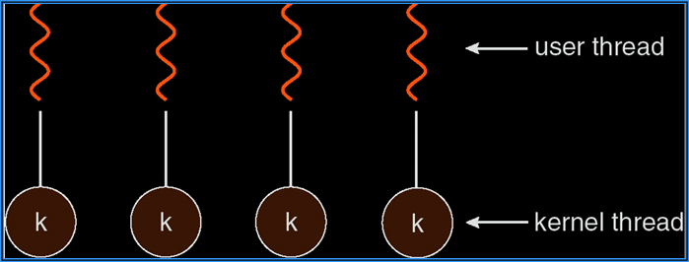
one-to-one

Slide 25
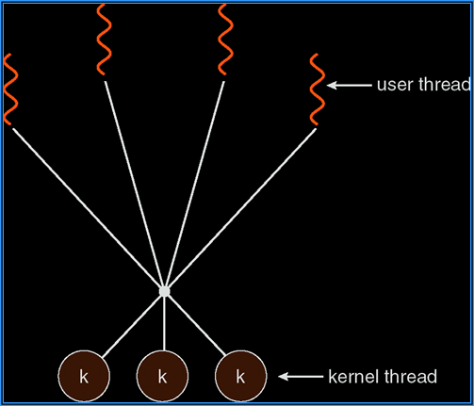
Many-to-many

Slide 26
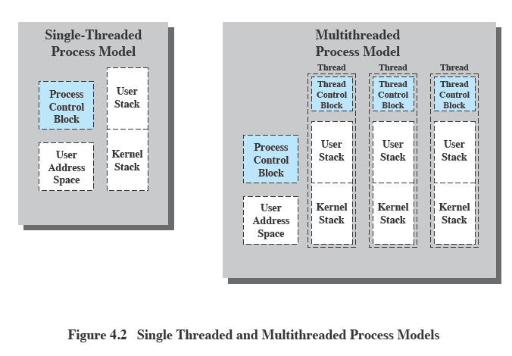
Threads vs. Processes

Slide 27
Benefits of Threads
  Takes less time to create a new thread than a process
  Less time to terminate a thread than a process
  Switching between two threads takes less time that switching processes
  Threads can communicate with each other without invoking the kernel

Slide 28
Virtual Machine
  Multiple Boot systems such as dual boot system
  VM OS provides approaches for creation of multiple virtual machines environments.
  Host OS and Guest OS
  Virtual Machine Resources

Slide 29
Monitors or Hypervisor
  The software runs at the top of the host OS is called as VM Monitor.
  Each VM provided by VM Monitor runs the guest OS.
  Example : VMware

Slide 30
Shell Programming
  Linux services can be accessed through command line options called as shell commands.
  Text file containing all shell commands which will be executed sequentially is called as shell script.
  Shell acts as an interface between the kernel and the user.

Slide 31
Directory Related Commands
cd
pwd
dir
mkdir
rmdir
touch
ls
cp
mv
ln

Slide 32
To display contents of file
To display a content of file type cat “filename”
Vi “filename” is used to display the file in vi editor.
gedit “filename” is used to display the file in gedit but only in GUI.

Slide 33
File Access Permission
Since Linux is a multi-user OS, it is necessary to protect the user’s files from any unauthorized access of other users.
UNIX offers a facility called File Access Permission (FAP) which helps us in preventing un-authorized access.
$ ls -l
total 1
-rw-r--r-- 1 teit01 teit01 10 Jul 1 10:30 sample

Slide 34
File Access Permission
$ chmod +x sample
grants execute permission.
$ chmod u+x sample
grant execute permission for the user.
$ chmod -x sample.c
revokes execute permission.
$ chmod 777 sample.c
grants all permission to asample.c. Decimal number 7 stands for 111 binary.

Slide 35
Redirection
Redirection directs the data flow that is received from the standard input and displayed on the standard output.
When output from a process is redirected to sources other than the standard output is called output redirection.
$ date > today
We can also redirect the input for a command using input redirection.
$ cat < names ($ cat names)

Slide 36
Pipes and Filters
In Linux, commands were created to perform only single tasks. It is not possible to perform multiple tasks in one command.
Redirection provides an answer to this problem. But it creates a number of temporary files, which are redundant and occupy more space.
Pipes and filters are used to overcome this problem.

Slide 37
Pipe
A pipe is a mechanism, which accepts the output of a command as its input for the next command.
$ who | wc -l
$ cat data | head -5

Slide 38
Filters
Filters are used
to extract the lines that contain a specific pattern
to arrange the contents of a file in a sorted order
to replace the existing characters with other characters
to extract specific columns of a file
merge two or more files together using filters.

Slide 39
Filters
sort
grep
egrep
fgrep
uniq
more
cut
paste
tee
tr

Slide 40
Redirection and Pipes
The simple concepts of standard input, output, and error become significantly more powerful when used with redirection and pipes.
cat file1 file2
cat file1 file2 > file3
cat file1 file2 >> file3
ls -l | more
cat file1 file2 | sort > file3

Slide 41
Wild Card Pattern
There are various wild card patterns available while searching files.
* is used for representing zero or more number of characters. ? character is used to represent a single character. [ ] is used to access a subset of related files.
$ ls a*
$ ls a?
$ ls a[123]

Slide 42
Managing users and groups
useradd
usermod
userdel
passwd

Slide 43
Process Management
ps
kill
pstree
killlall
top
nice
renice

Slide 44
Shell
Shell is acting as the interface between user and kernel. Shell is acting as a command interpreter.
There are various types of shell such as
  sh : standard shell
  bash : born again shell, most popular shell
  csh : c shell
  tcsh : tc shell
  ksh : Korn shell
  rsh : restricted shell

Slide 45
Shell Script
A set of commands that has to be performed repeatedly is grouped into a batch file in DOS.
Shell scripts are also similar to DOS batch files.
Use any editor like vi or gedit to write shell script. .sh extension is used to identify shell script file.

Slide 46
Executing Shell Script
$ vi sample.sh
# My first shell script
clear
echo “Welcome to Shell Programming"
Executing shell script :
$ sh sample.sh
OR
$ chmod +x sample.sh
$ ./sample.sh

Slide 47
Use of IF loop
if [ $1 -gt 0 ]
then
echo "$1 is positive"
elif [ $1 -lt 0 ]
then
echo "$1 is negative"
elif [ $1 -eq 0 ]
then
echo "$1 is zero"
else
echo "$1 is not number, give number"
fi

Slide 48
Use of FOR loop
for i in 1 2 3 4 5
do
echo "Welcome $i times"
done
OR
for (( i = 0 ; i <= 5; i++ ))
do
echo "Welcome $i times"
done

Slide 49
Use of CASE loop
echo “Menu”
echo “1. Your Current working directory”
echo “2. Today’s date”
echo “3. List of users logged in”
echo “your Choice”
read choice
case $choice in
  1) pwd;;
2) date;;
3) who;;
*) echo “invalid Choice”
esac

Slide 50
Use of WHILE loop
ans=“Y”
while [ $ans = y –o $ans = Y ]
do
echo “Menu”
echo “1. Your Current working directory”
echo “2. Today’s date”
echo “3. List of users logged in”
echo “your Choice”
read choice
case $choice in
  1) pwd;;
2) date;;
3) who;;
*) echo “invalid Choice”
esac
echo “Do You want to continue (y or Y)”
read ans
done

Slide 51
Use of UNTIL
choice=0;
until [ $choice –eq 4 ]
do
echo “Menu”
echo “1. Your Current working directory”
echo “2. Today’s date”
echo “3. List of users logged in”
echo “your Choice”
read choice
case $choice in
  1) pwd;;
2) date;;
3) who;;
*) echo “invalid Choice”
esac
done

Slide 52
Use of UNTIL FALSE
until false
do
echo “Hello”
sleep 5
done

Slide 53
Command Line Parameters
The Shell need not wait for the user to input data and hence execution becomes faster.
The arguments are named as $1, $2 etc. $0 stands for the command itself. $* stands for the list of arguments and $# gives the total number of arguments. The maximum number of positional parameters can be $9.
$ sh sample.sh “10” “20”

Slide 54
Test on Character String
-z zero length character sequence
-n non-zero length ,,
-f file
-d directory
-r read permission for the user
-w write permission for the user
-x execute permission for the user
-s empty file

Slide 55
Test on Character String
echo “Enter your name”
read name
if [ -z “$name” ]
then
echo “Name not entered”
exit
else
echo “Hello $name”
fi

Slide 56
Test on File
echo “Enter your File name”
read file
if [ -f “$file” ]
then
echo “File”
else
echo “Not a file”
fi

Slide 57
Shell Functions
A Shell function is a group of commands that is referred to by a single name from the command line.
These are similar to Shell scripts except that they can be executed directly by the Shell.
$ home ( } {
ls -l | grep .^d.
}

Slide 58
Shell Program - 1
echo "Enter You Name : "
read name
echo "Hello $name Welcome to Shell programming"

Slide 59
Shell Program - 2
echo "Enter first number : "
read a
echo "Enter Second number :"
read b
c=`expr $a + $b`
echo "Addition is :"
echo $c

Slide 60
Shell Program - 3
clear
echo "Enter First Number :"
read a
echo "Enter Second number :"
read b
while true
do
echo "1.ADD 2.SUB 3.MUL 4.DIV 5.REM 6.EXIT"
read choice
case $choice in
1) c=`expr $a + $b`
echo "The Addtion is “
echo $c;;

Slide 61
Shell Program - 3
3) echo "The Multiplication is "
echo $(( $a * $b ));;
4) c=`expr $a / $b`
echo "The division is "
echo $c;;
5) c=`expr $a % $b`
echo "The Remainder is "
echo $c;;
6) exit;;
*) echo "Invalid Choice"
esac
read
done

Slide 62
Shell Program - 5
# program to reverse a string
echo " Enter string :"
read str
len=`echo $str | wc -c`
echo $len
len=`expr $len - 1`
while test $len -ne 0
do
temp_char=`echo $str | cut -c $len`
rev_str=${rev_str}${temp_char}
len=`expr $len - 1`
done
echo $rev_str

